Slide 2
RENOUROGENITAL PHYSICAL EXAM IN PEDIATRIC
Zahra Pournasiri,MD
Pediatric Nephrologist,
SBMU
www.drpournasiri.com

Slide 3
Blood Pressure measurement

Slide 4
Sphygmomanometer

Slide 5
Choosing the Correct Blood Pressure Cuff (Sphygmomanometer)

Slide 7
As you palpate the radial artery with the fingers of one hand, rapidly inflate the cuff until the radial pulse disappears. Read this pressure on the manometer and add 30 mm Hg.

Slide 9
Korotkoff sounds,
The Korotkoff sounds are believed to originate from a combination of turbulent blood flow and oscillations of the arterial wall. Of note, some believe that using the Korotkoff sounds instead of direct intra-arterial pressure typically gives lower systolic pressures, with one study finding a 25 mmHg difference between the 2 methods in some individuals. ^{[6, 7]} Furthermore, some disagreement exists as to whether Korotkoff phase IV or V correlates more accurately with the diastolic blood pressure. Typically, phase V is accepted as the diastolic pressure due to both the ease of identifying phase V and the lower discrepancy between intra-arterial pressure measurements and pressures obtained using phase V. ^{[8]} Phase IV, alternatively, is used to measure the diastolic pressure if a 10 mmHg or greater difference exists between the initiation of phase IV and phase V. This may occur in cases of high cardiac output or peripheralvasodilatation, children under 13 years old, or pregnant women.
Regardless of whether a manual or automated method is used, the blood pressure measurement is a key part of clinical medicine. The following is a description of the indications, contraindications, and techniques for obtaining a blood pressure using both manual and automated devices.

Slide 10
Korotkoff Sounds
First Phase
A clear tapping sound; onset of the sound for two consecutive beats is considered systolic
Second Phase
The tapping sound followed by a murmur
Third Phase
A loud crisp tapping sound
Notes:
When measuring blood pressure we are listening for the Korotkoff sounds
First Phase
A clear tapping sound; onset of the sound for two consecutive beats is considered systolic
Second Phase
The tapping sound followed by a murmur
Third Phase
A loud crisp tapping sound
Fourth Phase
Abrupt, distinct muffling of sound, gradually decreasing in intensity
Fifth Phase
The disappearance of sound, is considered diastolic blood pressure- two points below the last sound heard

Slide 11
Korotkoff Sounds Cont.
Fourth Phase
Abrupt, distinct muffling of sound, gradually decreasing in intensity
Fifth Phase
The disappearance of sound, is considered diastolic blood pressure- two points below the last sound heard
Notes:
Fourth Phase
Abrupt, distinct muffling of sound, gradually decreasing in intensity
Fifth Phase
The disappearance of sound, is considered diastolic blood pressure- two points below the last sound heard

Slide 12
In some people, the muffling point and the disappearance point are farther apart.
This may occur in cases of high cardiac output or peripheralvasodilatation, children under 13 years old, or pregnant women.
If the difference is 10 mm Hg or greater,record both figures (e.g., 154/80/68).
Occasionally, as in aortic regurgitation,the sounds never disappear.

Slide 13
Measure Blood Pressure in Both Arms At Least Once.
A pressure difference of more than 10 to 15 mm Hg occurs in subclavian steal syndrome, supravalvular aortic stenosis,and aortic dissection, and should be investigated.

Slide 14
If the first two readings differ by more than 5 mm Hg, Wait 2 or more minutes and repeat.
Avoid slow or repetitive inflations of the cuff because the resulting venous congestion can cause false readings.
By making the sounds less audible,venous congestion may produce artificially low systolic and high diastolic pressures.

Slide 15
If the cuff is too small (narrow), the blood pressure will read high;
if the cuff is too large (wide), the blood pressure will read low on a small arm and high on a large arm.
If the brachial artery is below heart level, the blood pressure reading will be higher;
if the brachial artery is above heart level, the reading will be lower.
A loose cuff or a bladder that balloons outside the cuff leads to falsely high readings.

Slide 16
Orthostatic Hypotension
Measure blood pressure and heart rate in two positions—supine after the patient is resting from 3 to 10 minutes, then within 3 minutes once the patient stands up.
Normally, as the patient rises from the horizontal to the standing position, systolic pressure drops slightly or remains unchanged, whereas diastolic pressure rises slightly.
Orthostatic hypotension is a drop in systolic blood pressure of at least 20 mm Hg or in diastolic blood pressure of at least 10 mm Hg within 3 minutes of standing.

Slide 17
The Obese or Very Thin Patient.
For the obese arm, use a cuff 16 cm in width. If the upper arm is short despite a large circumference, use a thigh cuff or a very long cuff.
If the arm circumference is >50 cm and not amenable to use of a thigh cuff, wrap an appropriately sized cuff around the forearm, hold the forearm at heart level, and feel for the radial pulse.
Other options include using a Doppler probe at the radial artery or an oscillometric device.
For the very thin arm, consider using a pediatric cuff.

Slide 18
The Hypertensive Patient with Systolic Blood Pressure Higher in the Arms than in the Legs
Compare blood pressure in the arms and the legs and assess “femoral delay” at least once in every hypertensive patient.
In normal patients,the systolic blood pressure should be 5 to 10 mm Hg higher in the lower extremities than in the arms.
Coarctation of the aorta arises from narrowing of the thoracic aorta, usually distal to origin of the left subclavian artery, and classically presents with systolic hypertension greater in the arms than the legs.

Slide 19
To determine blood pressure in the leg, use a wide, long thigh cuff that has a bladder size of 18 × 42 cm, and apply it to the mid thigh. Center the bladder over the posterior surface, wrap it securely, and listen over the popliteal artery. If possible, the patient should be prone.
Alternatively, ask the supine patient to flex one leg slightly, with the heel resting on the bed.
Palpate the radial or brachial and the femoral pulses at the same time, and compare their volume and timing.
Normally, volume is equal and the pulses occur simultaneously.

Slide 20
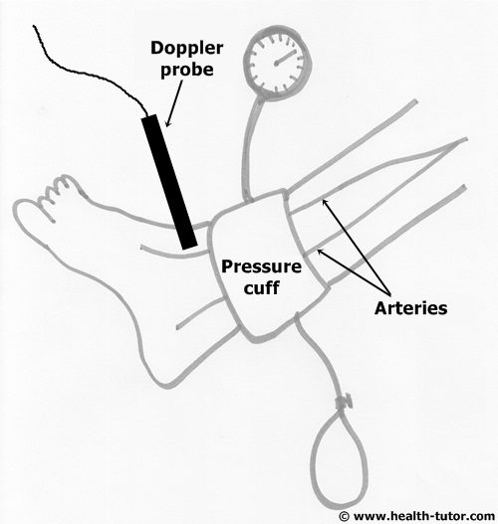
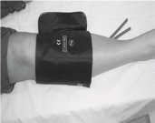

Slide 22
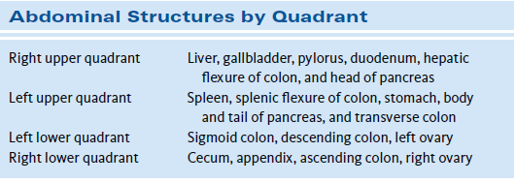
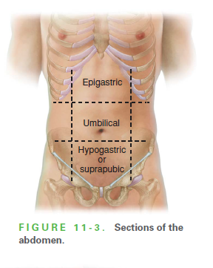

Slide 24
The kidneys are retroperitoneal (posterior) organs. The ribs protect their upper poles .

Slide 25
Percussion
The costovertebrar angle (CVA), formed by the lower border of the 12th rib and the transvers processes of the upper lumbar vertebrae, defines where to examine for kidney tenderness, called costovertebral angle tenderness (CVAT).
If the kidneys are tender to palpation,assess percussion tenderness over the CVAs. Pressure from your fingertips may be enough to elicit tenderness; if not, use fist percussion. Place the ball of one hand in the CVA and strike it with the ulnar surface of your fist .

Slide 27
Abdominal Bruits
If the patient has hypertension,auscultate the epigastrium and in each upper quadrant for bruits. Later in the examination, when the patient sits up, listen also in the CVAs.

Slide 28
Test for shifting dullness
A protuberant abdomen with bulging flanks is suspicious for ascites, the most common complication of cirrhosis or nephrotic sx.
Because ascitic fluid characteristically sinks with gravity, whereas gas-filled loops of bowel rise, dullness appears in the dependent areas of the abdomen. Percuss for dullness outward in several directions from the central area of tympany.

Slide 29
Shifting dullness.
Percuss the border of tympany and dullness with the patient supine, then ask the patient to roll onto one side. Percuss and mark the borders again .
In a person without ascites, the border between tympany and dullness usually stays relatively constant.

Slide 30
Test for a fluid wave.
Ask the patient or an assistant to press the edges of both hands firmly down the midline of the abdomen. This pressure helps to stop the transmission wave through fat.
While you tap one flank sharply with your fingertips, feel on the opposite flank for an impulse transmitted through the fluid

Slide 31
Edema

Slide 32
Pitting edema

Slide 33
Lymphedema of the feet in an infant with turner sx

Slide 34
Physical examination of the testicles
(a) Appearance ofempty left hemi-scrotum.
(b) Application of pressure at external inguinal ring, directed toward scrotum.

Slide 35
(c) Palpation of right testicle.
(d) Application of pressure at the left external ring.

Slide 36
(e). Attempt at palpating the left testis between index finger and thumb.
(f)Milking movement of finger and thumb distally in an attempt to delineate testis.

Slide 37
Transillumination

Slide 38
The cremasteric reflex
is a type of superficial reflex that is present only in the human male. It involves the involuntary contraction of the cremaster muscle when the inner portion of the thigh is lightly stroked.
This causes the scrotum and testicle to be pulled into an upward direction.
Its absence in older males may sometimes indicate health concerns such as testicular torsion, spinal injury, or a variety of motor neuron disorders.

Slide 40
Measurement of Penile Length
the glans penis should be held with the thumb and forefinger, and the measurement should be taken from the pubic ramus to the distal tip of the glans penis over the dorsal side.
The suprapubic fat pad should be pressed inwards as much as possible, and if present, the foreskin must be retracted during the measurement

Slide 41
A different approach involves the use of a 10 mL disposable syringe. The needle-side tip of the syringe is cut off, and the piston is inserted into the syringe on the cut side .
The open side of the syringe is placed on the penis. The piston is pulled back while pressing the fat pads inwards, which causes the penis to be pulled inside the syringe as a result of suction.
Once the penis is stretched inside the syringe, penile length is read from the scale added on the modified syringe.

Slide 42
MICROPENIS

Slide 43
Concealed(buired) penis

Slide 44
Buried penis (a), which may be visualized by retraction of the skin lateral to the penile shaft (b).

Slide 45
Phimosis refers to a conical protrusion of prepuce that cannot be retracted proximally.

Slide 46
Paraphimosis

Slide 47
Penile adhesion
Whitish yellow mucosal attachments are noted between the prepuce and shaft of the penis.

Slide 48
Glanular adhesions and skin bridges are attachments of the glans and penile shaft, which are common complications associated with circumcision.

Slide 49
Coronal hypospadias.
Note the ventral meatus and associated hooded prepuce.

Slide 50
Perineal hypospadias

Slide 53
Hypospedias

Slide 54
Testicular torsion

Slide 55
Chordee
A ventral curvature of the penis is evident

Slide 56
Penile torsion
Note the counterclockwise rotation of the penile meatus and shaft.

Slide 57
AMBIGUS GENITALIA

Slide 58
Webbed Scrotum

Slide 59
Bifid Scrotum

Slide 60
Aphallia

Slide 61
MEATAL STENOSIS

Slide 62
Meatal duplication

Slide 63
Hydrocele

Slide 64
TORSION OF THE APPENDIX TESTIS
"blue dot" sign
The appendix testis is a 0.3 cm pedunculated structure on the anterosuperior aspect of the testis. Torsion can produce testicular pain that ranges from mild to severe. Infarction and necrosis of the appendix testis can be seen as a "blue dot" sign

Slide 66
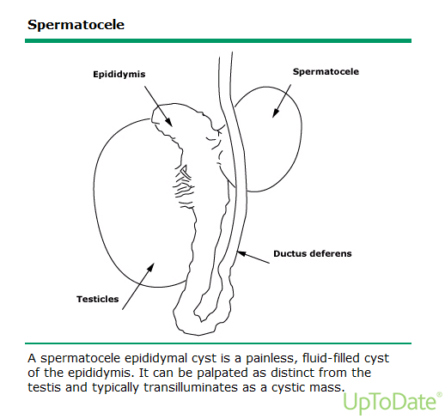

Slide 68
Irritant contact dermatitis

Slide 69
Diaper candidiasis

Slide 70
Diaper dermatitis

Slide 71
Zinc def.

Slide 72
Infantile seborrheic dermatitis involving the diaper area

Slide 73
Yellow-brown and erythematous papules, erosions, and crusts are present on this infant with Langerhans cell histiocytosis.

Slide 74
Nonhealing Diaper Rash with Associated Hepatosplenomegaly
Langerhans cell histiocytosis.

Slide 75
scabis
A papular erythematous eruption in the diaper area of a one-year-old baby.

Slide 76
Congenital syphilis
They may be seen in the diaper area and/or around the mouth and nose and are characteristically copper-colored, scaly macules and papules or moist erosions .

Slide 77
Infantile psoriasis of the diaper area

Slide 78
Jacquet's erosive diaper dermatitis
is characterized by well-demarcated papules, nodules, and punched-out ulcerations in the perineal region .
Factors contributing to the development of Jacquet's erosive dermatitis include urinary incontinence, infrequent diaper changing, and chronic stooling.

Slide 80
Tag

Slide 81
Labial adhesions

Slide 82
BLADDER EXTROPHY

Slide 84
Vaginal l polyp in a newborn

Slide 85
Gartner's duct cysts in the newborn
Gartner duct cysts develop on the side walls of the vagina. This duct is present while a baby is developing in the womb but will most often disappear after birth.
If parts of the duct remain, they may collect fluid and develop into a vaginal wall cyst later in life.

Slide 86
Paraurethral (Skene’s Duct) Cyst
Characteristic appearance of Skene's duct cyst in a female newborn
The paraurethral glands and ducts known to form as the outpouching of the urethra during the third gestational month are homologs of the male prostate.
The paraurethral glands which are between 6 and 30 in number, have their own ducts that open just inside the urethral meatus. The largest two of these are the paraurethral glands of Skene

Slide 87
The differential diagnosis of paraurethral Skene's duct cysts in newborns includes imperforate hymen, Gardner duct cyst, Mullerian duct cyst, urethral prolapse, rhabdomyosarcoma of the vagina, prolapsed ectopic ureterocele, condyloma, urethral polyp, congenital lipoma and vaginal prolapse.

Slide 88
PRUNE BELLY SYNDROM

